Slide 1

Traffic Accident Analysis – Bengaluru
KEERTHAN KUMAR L V

Slide 2
Introduction Traffic accidents are a major concern in urban areas, impacting public safety and infrastructure efficiency. Bengaluru, being a high-traffic metropolitan city, faces challenges related to road safety due to congestion, weather conditions, and driver behavior. This report examines accident trends from January to April 2023, using data on locations, severity, time of occurrence, and weather conditions. By analyzing patterns, we aim to identify high-risk areas and factors contributing to accidents, ultimately guiding recommendations for improving road safety.
.

Slide 3
Dataset Overview
The dataset records traffic accidents in Bengaluru from January to April 2023, detailing the following attributes:
Date & Time: Helps analyze peak accident hours.
Location: Identifies high-risk areas.
Severity: Categorized as Minor, Major, or Fatal.
Weather Conditions: Includes Clear, Rain, and Fog to understand external impacts.
Month: Assists in tracking seasonal patterns.
This dataset provides valuable insights into accident hotspots, severity trends, and environmental influences on road safety. It serves as a foundation for analysis aimed at improving infrastructure and reducing accident occurrences.

Slide 4
Key Findings: Location, Time, Weather
1. High-Risk Locations
Fatal Accidents: Hebbal Flyover, Bellandur Outer Ring Road – These locations require urgent safety measures.
Major Accidents: Silk Board Junction, Electronic City Phase 1 – High congestion and frequent collisions indicate possible infrastructure issues.
Minor Accidents: Spread across multiple areas such as Koramangala, Madiwala, and Whitefield.
2. Time-Based Trends
Morning (6 AM - 12 PM): Mostly minor accidents, likely due to peak-hour traffic.
Evening & Night (6 PM - Midnight): Increased major and fatal accidents, possibly due to reduced visibility, reckless driving, or fatigue.

Slide 5
3. Weather Influence
Clear Weather: Higher occurrences of minor accidents, suggesting typical road issues.
Rain & Fog: More major and fatal accidents, indicating that adverse weather
significantly affects road safety.
These insights highlight the need for better road infrastructure, increased awareness,
and weather-specific driving precautions to enhance safety measures

Slide 6
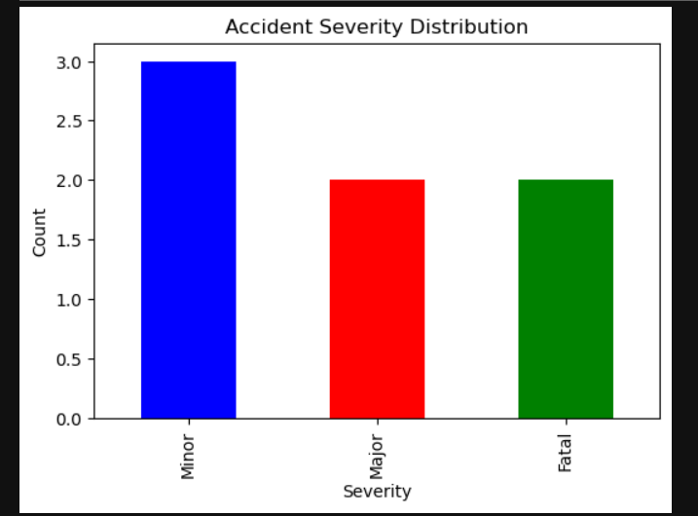

Slide 7
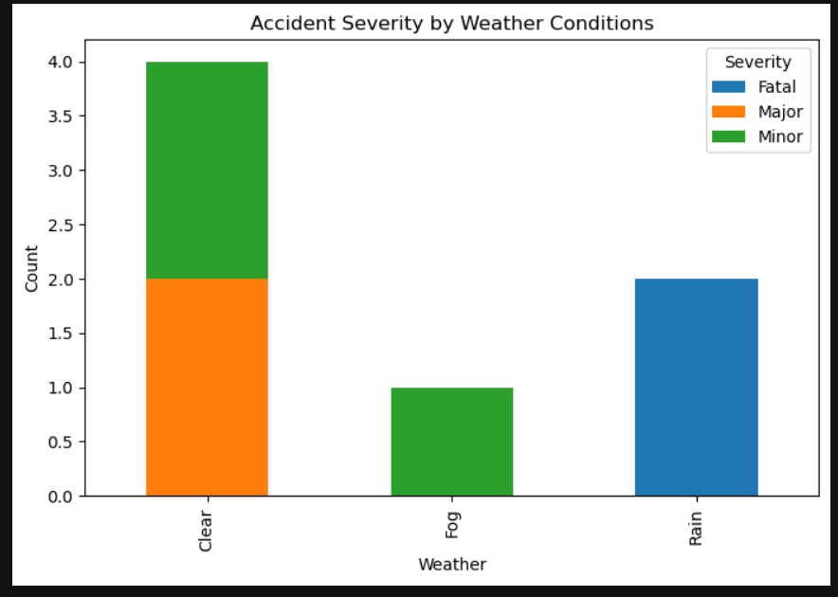

Slide 8
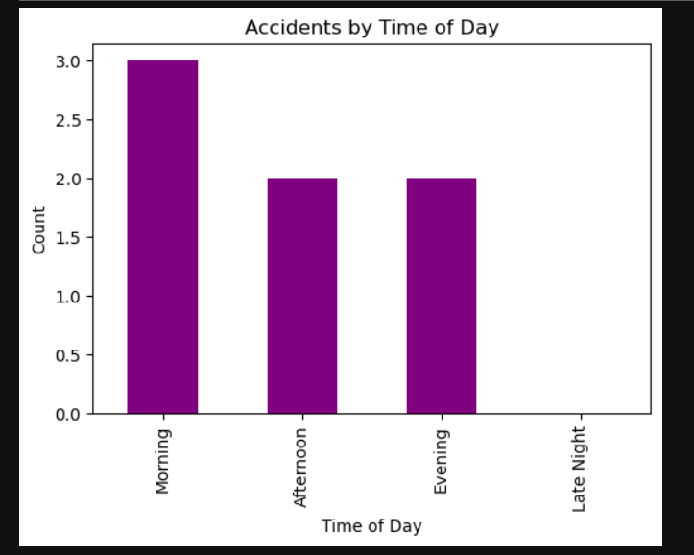

Slide 9
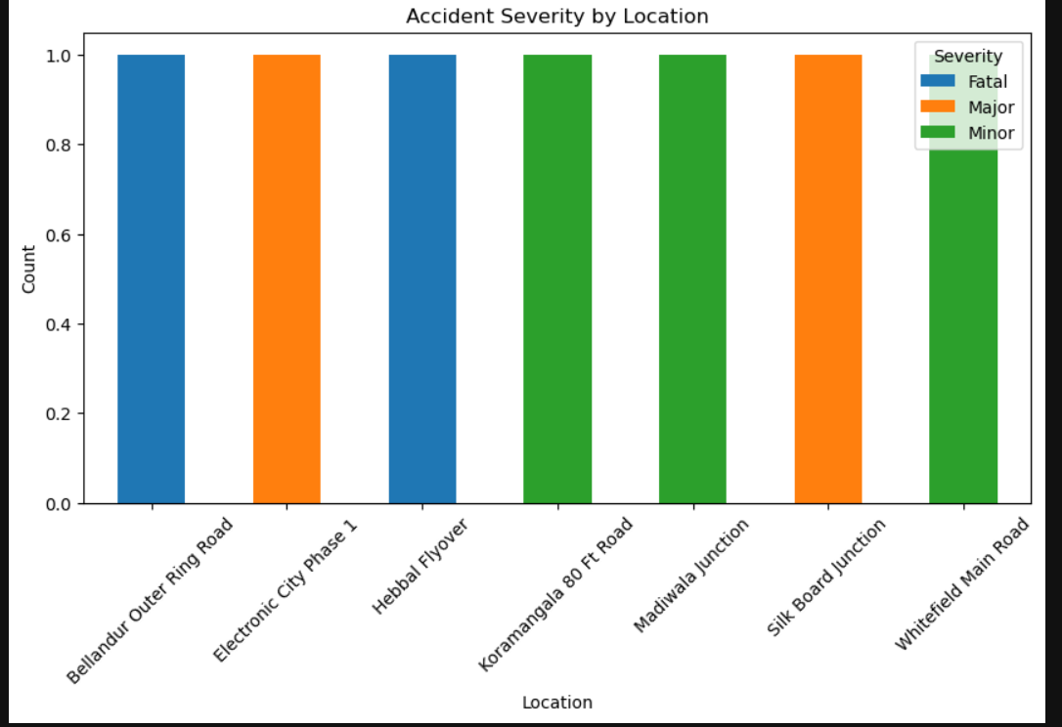

Slide 10
Conclusions
The analysis of traffic accidents in Bengaluru from January to April 2023 highlights key risk factors affecting road safety. Based on the dataset, we can conclude:
High-Risk Locations:
Fatal accidents were observed at Hebbal Flyover and Bellandur Outer Ring Road— indicating the need for improved safety measures.
Silk Board Junction and Electronic City Phase 1 recorded major accidents, possibly due to heavy congestion.
Time-Based Patterns:
Morning (6 AM - 12 PM): More minor accidents, likely due to rush hour traffic.
Evening & Night (6 PM - Midnight): Increased major and fatal accidents, suggesting reduced visibility and higher risks.
Weather Conditions & Accident Severity:
Clear weather: Mostly minor accidents, implying regular traffic issues.

Slide 11
Recommendations:
✅ Improve road safety infrastructure at high-risk locations, including better lighting and speed management. ✅ Implement stricter traffic regulations during peak accident hours. ✅ Raise awareness about safe driving in adverse weather conditions. ✅ Explore predictive modeling for proactive accident prevention strategies.

